Slide 1


WeatherSight: Long-Term Weather Forecast Marketing Platform
Presented by: Aviv Aytek, Idan Aizenberg
Supervisor: Dr. Zekharia Frenkel
Software Engineering Department, Capstone Project Phase A

Slide 2

Introduction
The Need for Long-Term Forecasts
Long-term weather forecasts are crucial for strategic planning across many industries, influencing decisions from crop planting to logistical routes.
However, these forecasts often lack accessibility and practical actionability for end-users, leading to missed opportunities and increased risks.
Our Objective
To develop a platform that simplifies access to, and utilization of, long-term weather data, empowering users with actionable insights.

Slide 3



The Problem
Data Fragmentation
Lack of User-Friendly Tools
Non-Tailored Forecasts
Weather data is scattered across numerous providers, each with different formats, update frequencies, and access methods.
Existing tools are often complex, requiring technical expertise to extract meaningful information, hindering broad adoption.
Generic forecasts rarely meet the specific, nuanced needs of diverse industries, leading to irrelevant or incomplete insights.

Slide 4




Solution Overview
WeatherSight provides a unified platform designed to overcome data challenges, delivering tailored and actionable long-term weather forecasts.
Customer-Driven Filtering & Query Builder
Clear, Action-Ready Insights
Create, save, and share custom filters-location, dates, thresholds for instant tailored insights.
We translate complex, multi-source weather data into clear, action-ready insights, helping users make informed decisions quickly.
Sector-Specific Insights
Subscription Model
Customized visualizations and alerts, precisely tailored to meet industry-specific requirements.
WeatherSight offers four tiers: Basic (free, limited data), Standard (30-day forecasts), Professional (advanced models, alerts), and Enterprise (full access, real-time alerts, API).

Slide 5

Target Audience
Agriculture
Real Estate
Urban Planning
Logistics
Insurance
Military Purposes
Energy
Private Users
Government

Slide 6
System Overview & Architecture
WeatherSight is built on a robust, modular architecture designed for scalability and reliability.
Data Ingestion: Collects weather data from files or internal sources using ETL pipelines built with Node.js and SQL.
Backend Services: Processes, analyzes, and manages data flow using Node.js with Express.
Database: Securely stores historical and forecast data using PostgreSQL or mySQL.
Frontend: Web interface developed in React.js for user interaction, data queries, and visualizations.
Notification System: Delivers personalized weather alerts via email/SMS.

Slide 7
Platform Features
Intuitive Query Interface
Customizable Alerts
Effortlessly search for forecasts by location, time, and specific weather parameters.
Set personalized notifications for critical weather events relevant to your operations.
Dynamic Visualizations
Forecast Export
Interactive charts and maps to easily understand complex weather data and trends.
Download forecast data in various formats for offline analysis and integration with other tools.

Slide 8
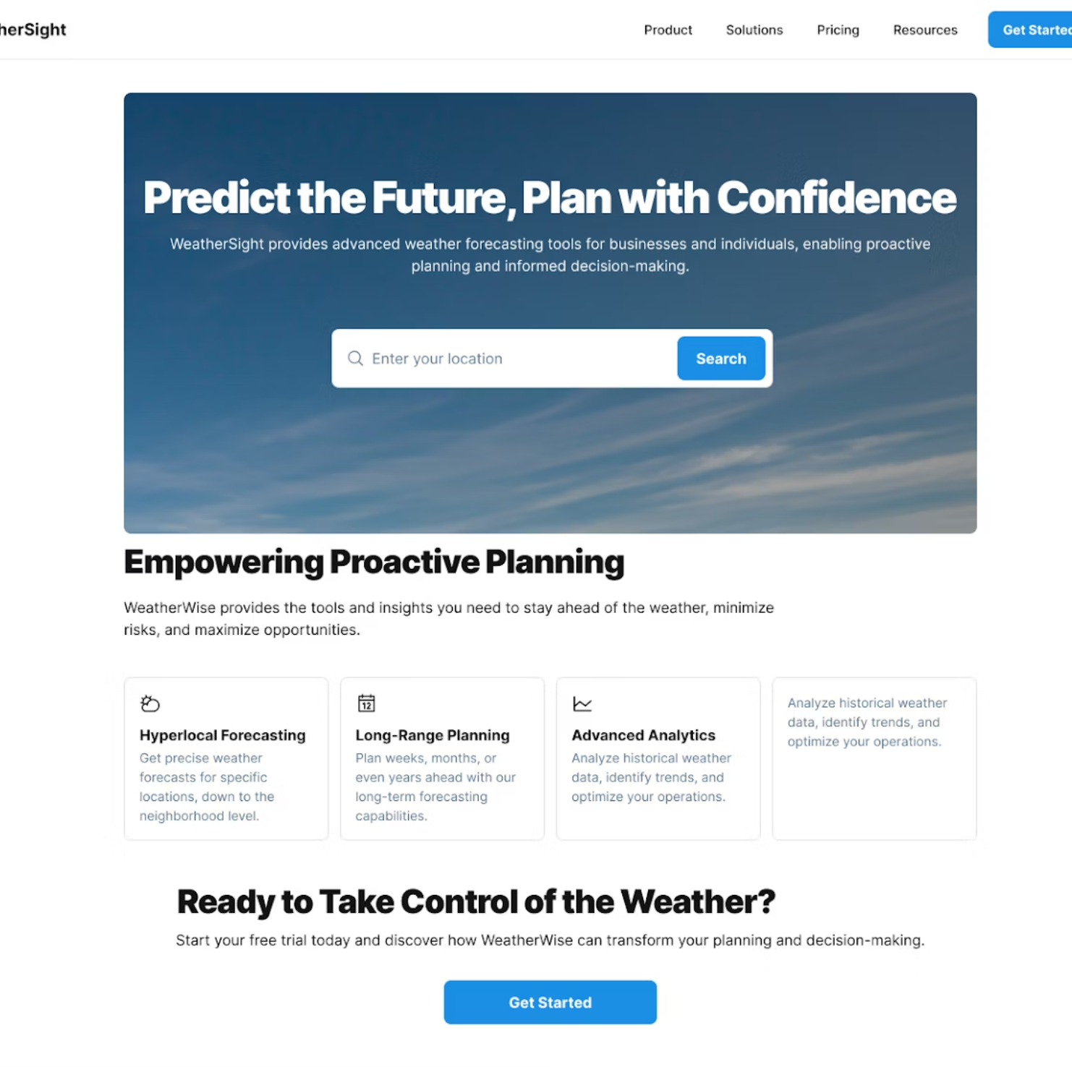
GUI
HOME PAGE-
From the Home Page, users log in to the platform

Slide 9
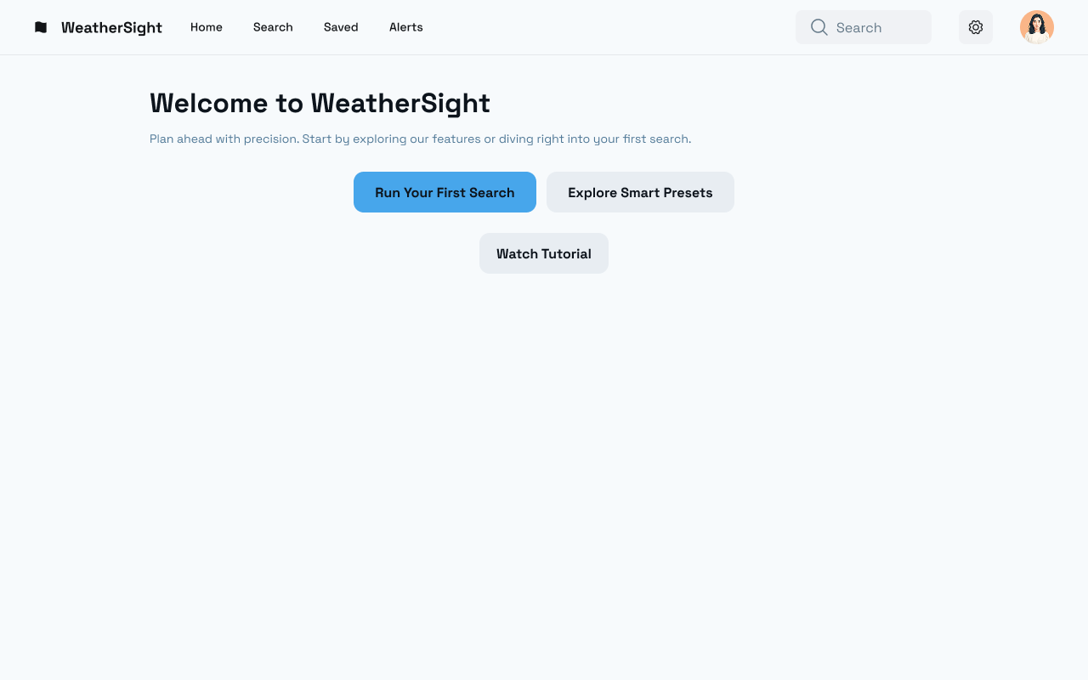
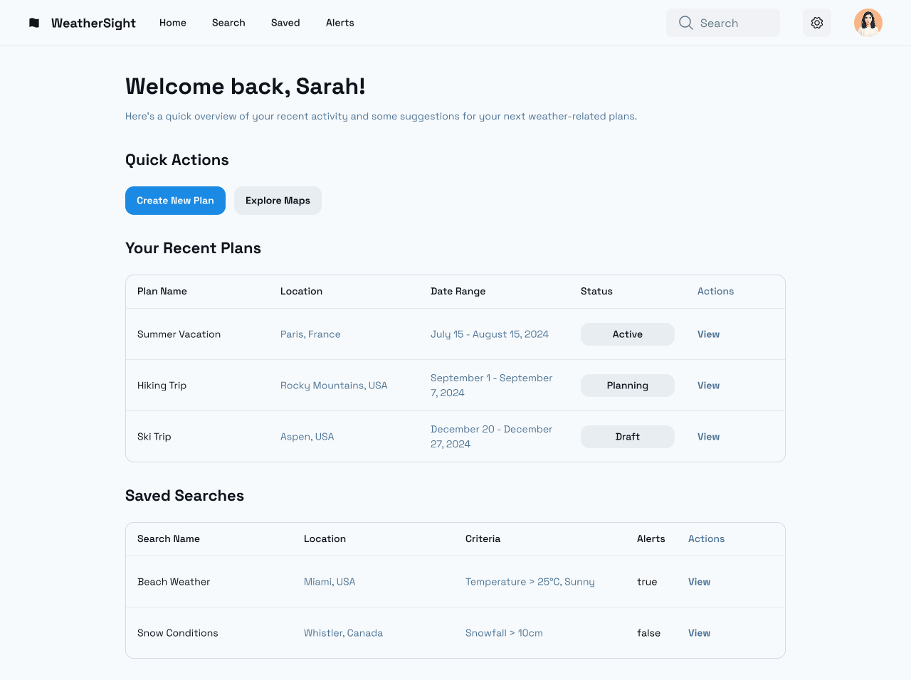
GUI
Dashboard Page-
First time user & registered user

Slide 10
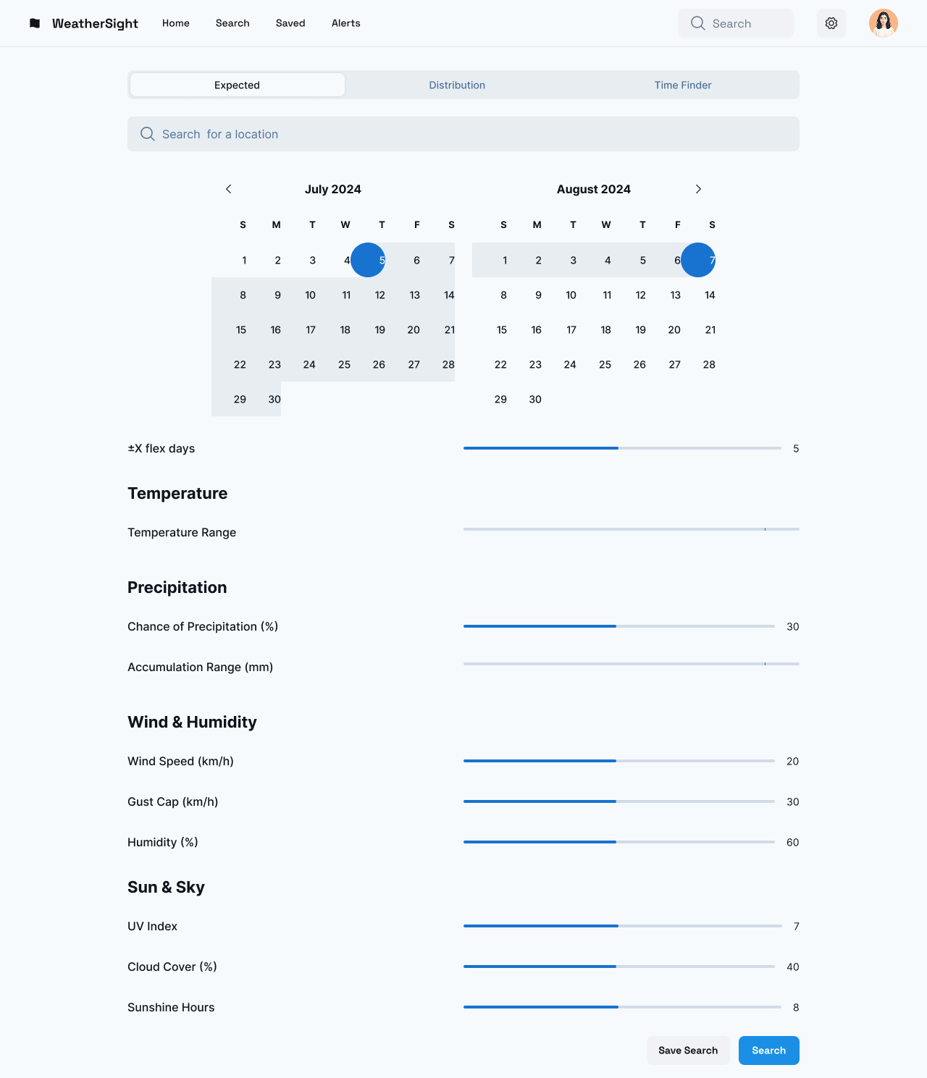
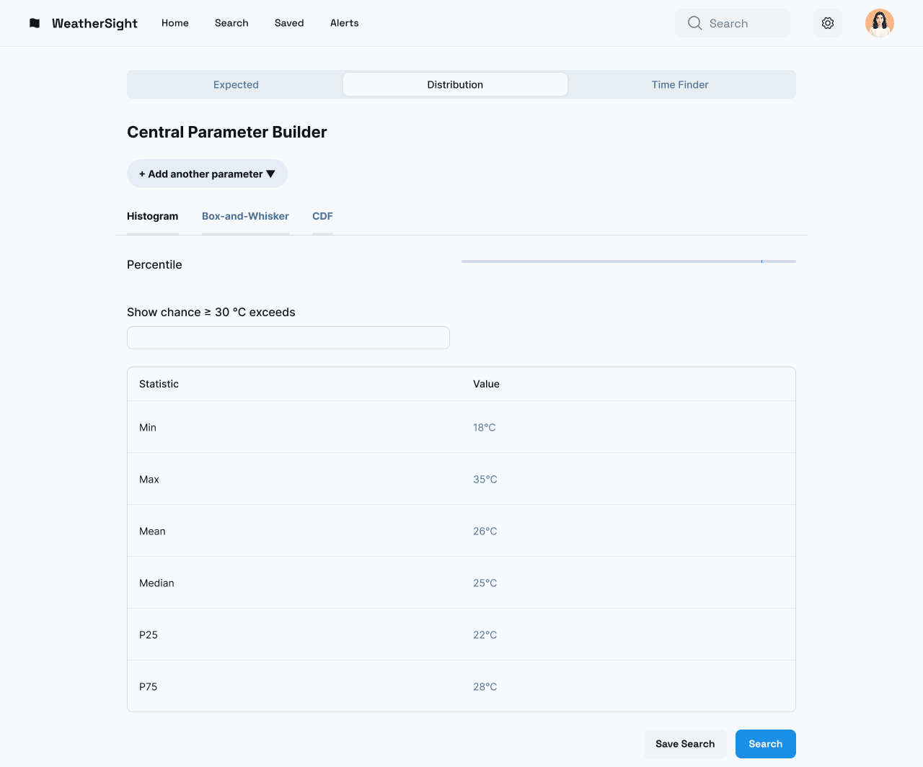
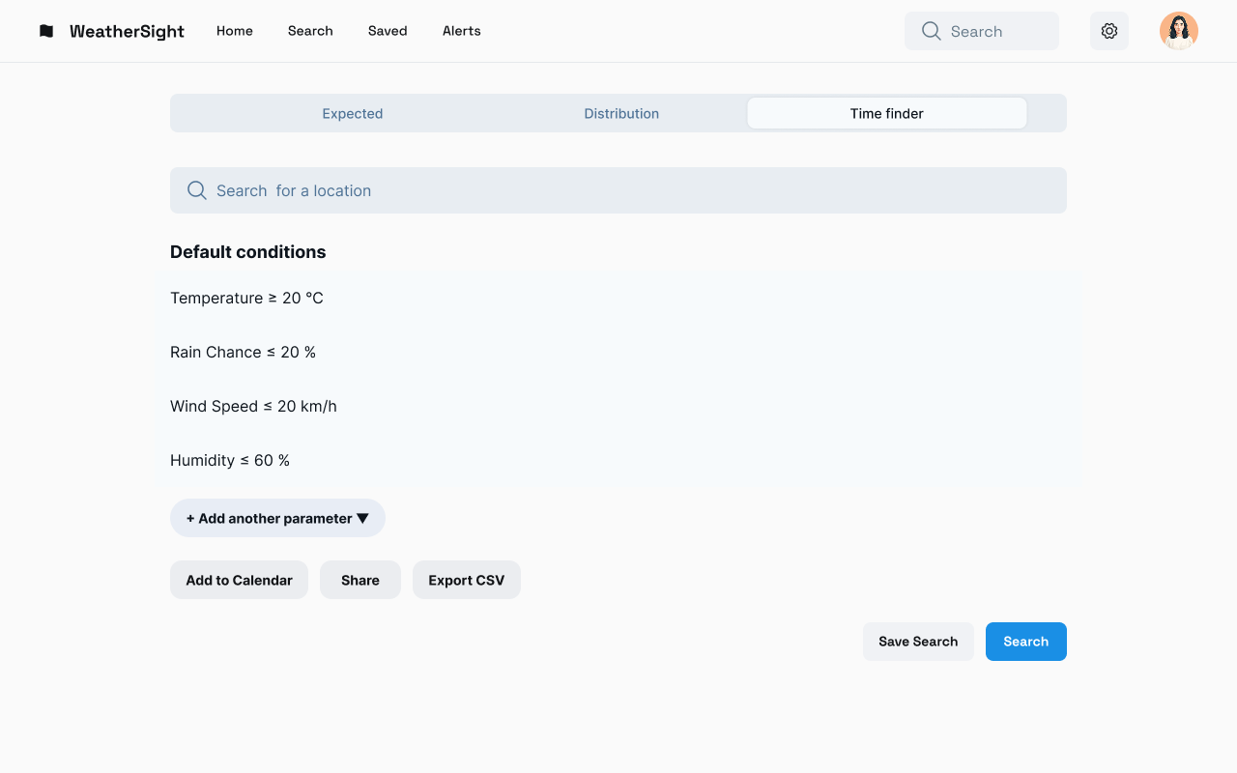
GUI
Search Page-
Multiple options for the search process

Slide 11
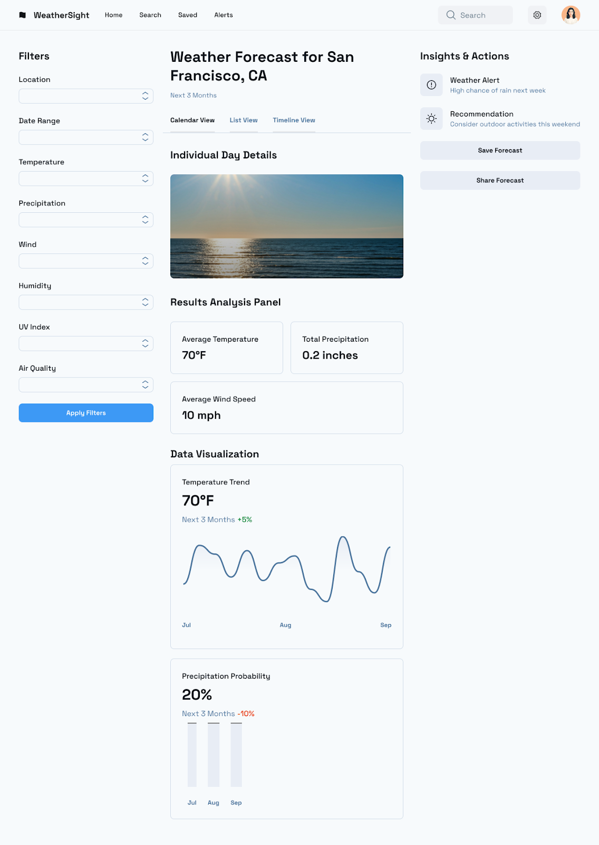
GUI
RESULTS PAGE

Slide 12
Expected Achievements
Technical Implementation
User Experience Design
Business Model Implementation
Accessibility and Internationalization

Slide 13

Thank You! Time for Questions

